Slide 1

LITERARY
LENS
BY:
Pragati Gupta
Prakhar
CSIT-1B

Slide 2
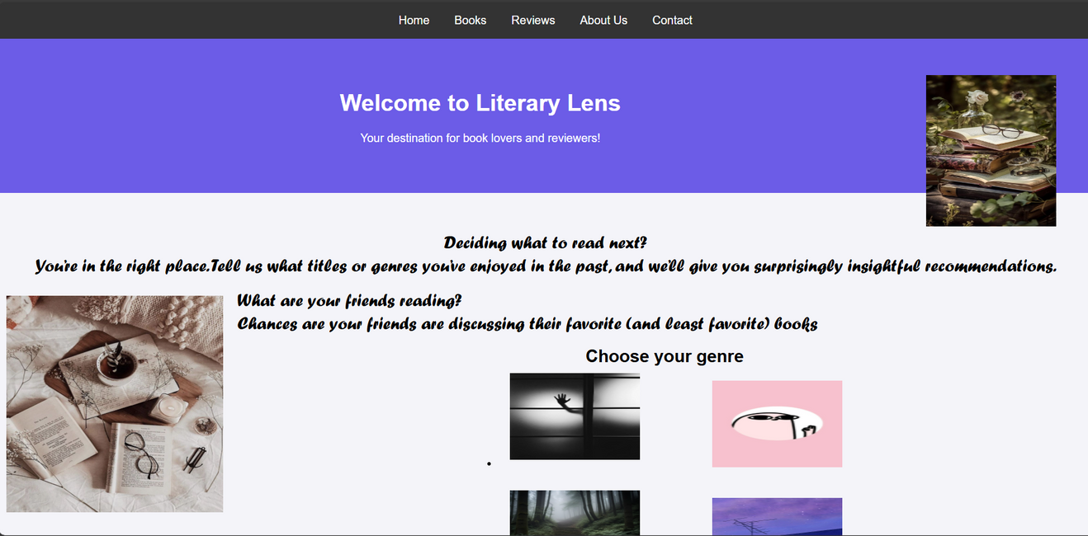
What is a book review website?
A platform where readers can share, discover, and read book reviews.
Connects book lovers with personalized book recommendations.

Slide 3


Why is it important?
Helps readers find books tailored to their preferences.
Provides a space for user-generated content (reviews, ratings, etc.).

Slide 4

Key features of website
Book Reviews: In-depth, user-generated reviews with a 1-5 star rating
Book Lists & Categories: Genres and themed lists

Slide 5
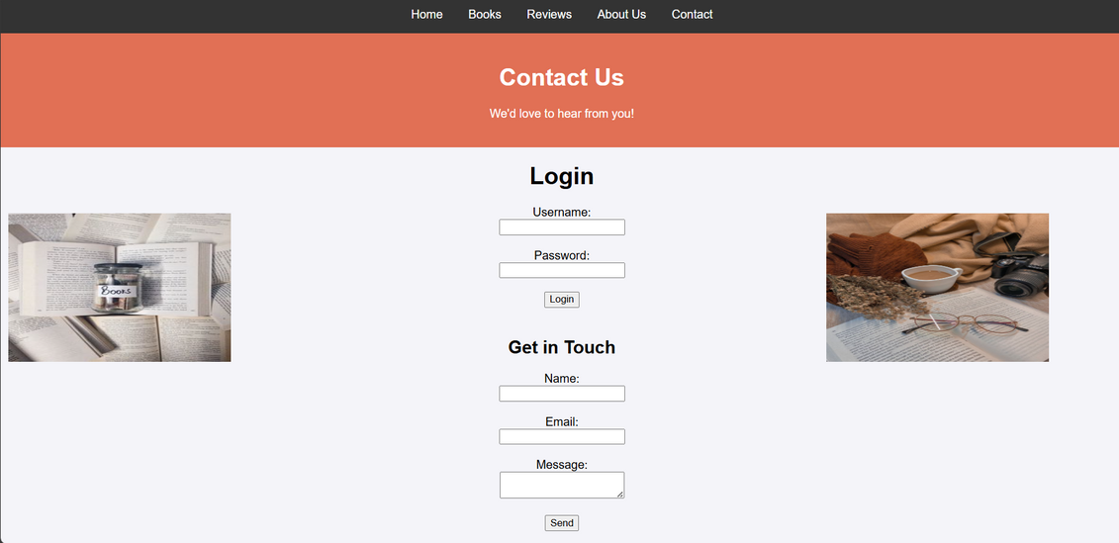
User Experiences
Intuitive Interface: Easy navigation and searchability for books.
Search & Filter: Advanced filtering options for genres, ratings, etc.
User Profiles

Slide 6

Html Tags
1. HEADING -<H1></H1> to <H6></H6>
2. PARAGRAPH - <P></P>
3. CENTER- <CENYTER></CENTER>
4. FONT- <FONT FACE = “” SIZE = “” COLOR = “”></FONT>
5. BODY- <BODY BGCOLOR = “” ></BODY>
6. BREAK A LINE -<BR></BR>
7. HR- <HR SIZE = “” COLOR = “” WIDTH = “”>
8. UNORDERED LIST -<UL> <LI> </UL>
9. ORDERED LIST -<OL> <LI> </OL>
10. INSERTING A IMAGE -<IMG SRC=”” ALIGN = “”>
11. INTERNAL LINKING -<A HREF=”#LINKNAME”>LINK TO ANOTHER SECTION OF THE SAME DOCUMENT </A>
<A NAME = “LINKNAME”>
12. EXTERNAL LINKING -<A HREF = “LINKNAME”>NAME TO THE LINK </A>
Html Tags

Slide 7

Basic CSS we used
We used internal css and inline css using the <style> tag and attributes of different tags such as
padding, the space around the content. In the example below, it is the space around the paragraph text.
border, the solid line that is just outside the padding.
margin, the space around the outside of the border.
width (of an element).
background-color, the color behind an element's content and padding.
color, the color of an element's content (usually text).
text-shadow sets a drop shadow on the text inside an element.
display sets the display mode of an element.

Slide 8
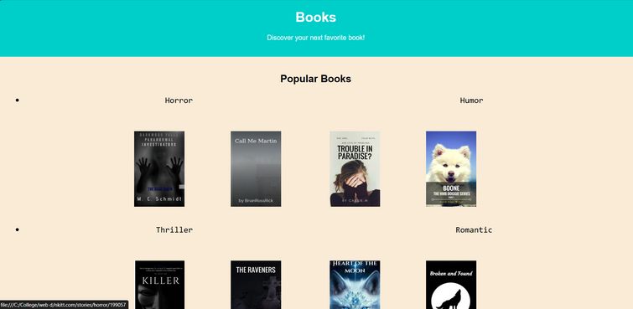
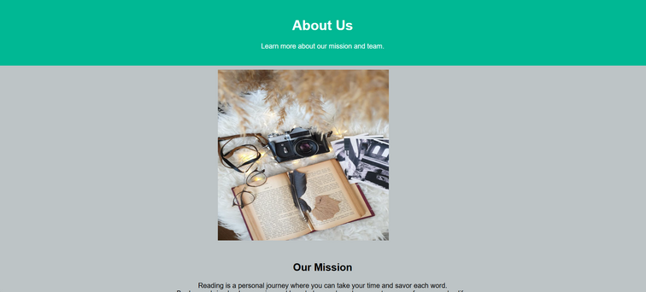
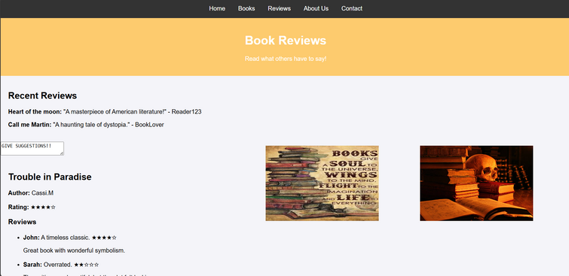
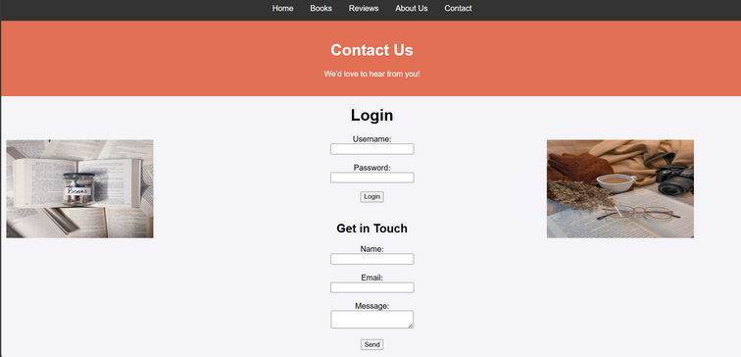
Website Pages

Slide 9

Potential Challenges
Fake Reviews: Addressing moderation of reviews to avoid spam or fraud.
Bias in Reviews: Ensuring diversity and fairness in review content.
Maintaining Engagement: Continuously providing fresh content and engaging users.

Slide 10
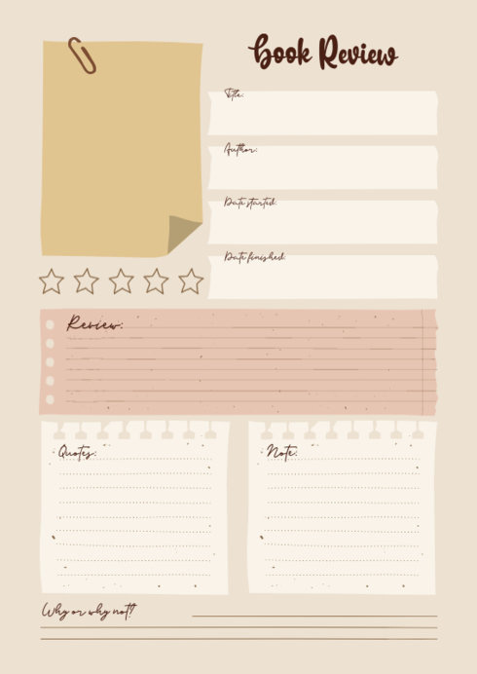
Role of Reviews
User-Generated Content: Reviews help fellow readers make informed decisions.
Quality Control: Users can upvote helpful reviews and flag inappropriate ones.
Influence on Book Sales: Positive reviews contribute to increased visibility and sales.

Slide 11

Looking ahead:Future Enhancements
AI-Powered Recommendations: Use machine learning for more precise book suggestions.
Partnerships with Libraries/Bookstores: Users could borrow or purchase books directly.
Expanded Social Features: Social media integration for easier sharing of reviews.

Slide 12



Why chose our website?
A diverse, interactive, and community-driven platform that makes discovering books easier.
Join thousands of readers in our vibrant community.
Call to Action: Sign up today and start exploring your next favorite book.

